Slide 1


A Division of Group of Companies

Slide 2


introduces
Guaranteed to amaze you.

Slide 3

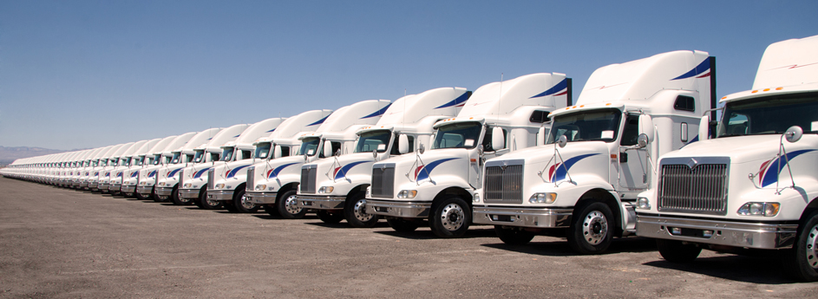
GPS Vehicle Tracking and Fleet Management Solutions
GPS VEHICLE TRACKING – LOGISTICS & FLEET MANAGEMENT

Slide 4
GPS Vehicle Tracking and Fleet Management Solutions
CURRENT CHALLENGES OF FLEET MANAGEMENT
Real time monitoring the status and position of the vehicle
Unnecessary idling identification of the vehicle
Unauthorized usage of the vehicle not diligently monitored
Tracking of late arrival and late departure of vehicle at the designated location is a tedious task
Difficulty in fleet maintaining & track of service records of vehicle
Waiting for the vehicle for long time, holds up other works in the priority

Slide 5

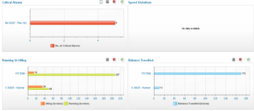

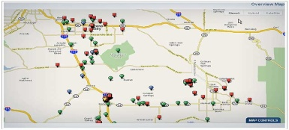






Trinetra Software Key Features – Web Based Anytime Anywhere
Dash Board
Configurations
Monitor
Reports
History
Trinetra Web-Application / Mobile Application
Geozones
Alarms
Landmarks

Slide 6
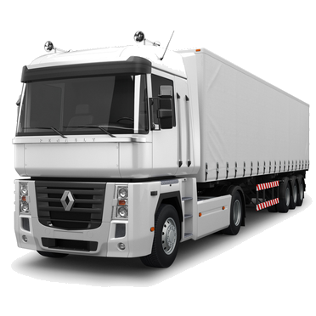
Fleet Management Working
TRINETRA KEY OFFERINGS
Real time monitoring of the vehicle
Track of records on locations and status Real time alerts & notifications
Define alerts easily based on violations Entire fleet management
Business oriented reports
Geozones & landmarks
Monitoring drivers behavior

Slide 7

Trinetra Software Key Features – Web Based Anytime Anywhere
USER FRIENDLY DASHBOARD:
Provides summarized fleet data in easy-to-understand charts and graphs
Enables to view the snap shot of entire fleet in one screen
Option to export the summarized data along with the chart in PDF and Excel
Dash Board
MONITOR:
Provides real time location & status of the vehicle in the digitalized map
Displays the warning and critical alerts generated in the last 24 hours with status indication
User can map the position of the selected vehicles by selecting it
Full screen view to view the list of the vehicle status in the selected fleet
Monitor
HiSTORY:
View the entire trip of the vehicle for the specified duration on the map with current position
Provides the information of point that is plotted in the map when the cursor is placed over it
Lists various trip information like physical location, date and time, speed, message details
Direction of travel in the grid along with the commands sent to the vehicle & its related details
History

Slide 8

Trinetra Software Key Features – Web Based Anytime Anywhere
ALERTS:
Provides the list of alerts generated
Acknowledge or close the selected alerts. Bulk acknowledgement / close of alarms is possible
Search for the alerts generated based on the fleet, severity, status, duration and the user who have acknowledged and/or closed the alert
Alarms
GEOZONES:
Create and manage rectangular, circular and polygon geozone using this module
The user can set and receive notifications with configuring, severity levels, direction for which the school bus has to trigger the message (None / In / Out / Both) & list of users to whom the notification related to the geozone has to be given
Geozones
Landmarks:
Create and manage custom landmarks by Street Address or by Geo location
When the school bus reaches a particular landmark instead of the street address or physical location the landmark will be displayed in the vehicle trip history
Landmarks

Slide 9


Trinetra Software Key Features – Web Based Anytime Anywhere
FLEET MAINTENANCE:
Manage services and maintenance for vehicles based on Odometer / Engine Hours / Time based
Track planned cost Vs Actual Cost for the service plan
Manage Email / notification for services nearing maintenance due period
Fleet Maintenance
REPORTS:
The software has a comprehensive list of reports that will help in decision making.
Schedule and receive reports on predefined intervals such as daily, weekly, monthly
- Standard Report - Fleet Maintenance
- Driver Management - Vehicle Utilization
Reports
CONFIGURATIONS:
A user friendly configuration panel allows you to manage your fleet based on user privileges
- User management - Vehicle Management
- Fleet Management - School management
- Scheduling of Commands
Configurations

Slide 10

Key Benefits
GPS VEHICLE TRACKING:
Comprehensive Vehicle Tracking
Improved conveyance management
Reduced administrative load
Dealing with unforeseen situations
Effective Route Management
Improved Customer Service
Increased Utilization from your fleets
Enhanced Vehicle & Driver Safety
Reduced Operational Costs
Reduced fuel costs
Save Money & Time

Slide 11
GPS Vehicle Tracking and Fleet Management Solutions
Any Questions and Feedbacks?
Please feel free to contact us at +974 30 255 927 | muhasin@carecomqatar.com
With “ TRINETRA - GPS Vehicle Tracking “ device installed in your vehicle, Educational Institutions can handle effective fleet management comprehensively and also respond in a better manner to unplanned emergencies

